Slide 1
Efficacy evaluation of ISOCLAST against Philaenus spumarius on weeds in semi-field, Italy, 2017.
David Valcárcel herrera
Supervised by Miguel Rodrigo Valverde Urrea

Slide 2
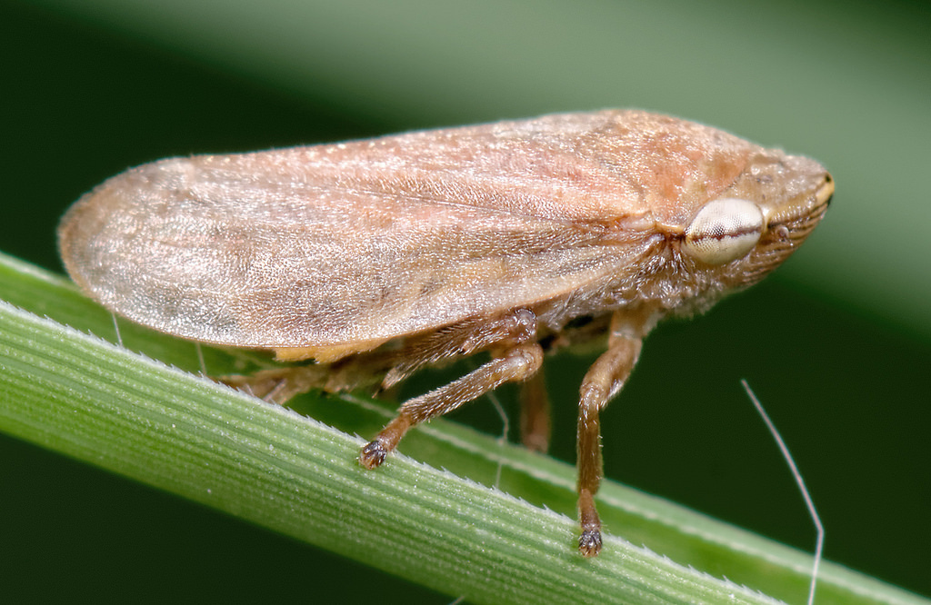
INTRODUCTION (BACKGROUND)
Background: Philaenus spumarius (“meadow spittlebug”) is a major vector of Xylella fastidiosa (also known as Pierce’s disease), a devastating plant pathogen in Europe.
Effective control of P. spumarius is important for managing Xylella outbreaks and ensuring crop health.
Several insecticides, including ISOCLAST™ (sulfoxaflor), are available to control sap-feeding pests such as the aforementioned. There is a need to assess and compare their efficacy and persistence of these products under semi-field conditions.
This photograph from https://www.marylandbiodiversity.com/species/11054 is under license CC BY

Slide 3
INTRODUCTION (OBJECTIVES OF THE STUDY)
Key Objectives:
Identify the most effective treatment/insecticide
It must be determined which of the tested products (see 2017 and 2018 tables) provides the highest efficacy against Philaenus spumarius under semi-field conditions in each year. We must also study if there is variability between plots, that is, if the plots have something to do with the differences between individual replicas.
Compare application methods
It must be assessed whether foliar spray or trunk injection is more effective for delivering each treatment.
Evaluate persistence of control
We should also measure how persistent each treatment is over time, and identify which offers the longest-lasting protection.

Slide 4
INTRODUCTION (EXPERIMENTAL PROCEDURE)
Experimental procedure
The field study was conducted on plots, each containing two trees (and four tree branches per tree in 2018, serving as sub-units). The assigned insecticide treatments were applied to each plot.
Insects (Philaenus spumarius) were introduced into a net enclosure placed on each tree, preventing all individuals from entering simultaneously and preserving the ability to assess insecticide duration.
Over multiple time periods, the number of live insects inside the enclosure was regularly recorded. When counts dropped, new insects were introduced according to the schedule.
Plot assignments to treatments (including untreated controls) were made via randomized block design.

Slide 5
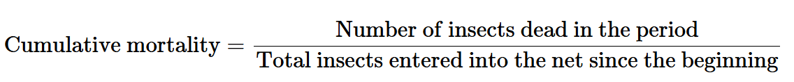
INTRODUCTION (EXPERIMENTAL PROCEDURE)
For each time period, cumulative mortality was calculated as:
This formula applies to each period in the study. Notice that the number of introductions of insects are not equal to the number of periods in the study.

Slide 6
1. WHICH insecticide is more effective against philaenus spumarius? (2017)

Slide 7
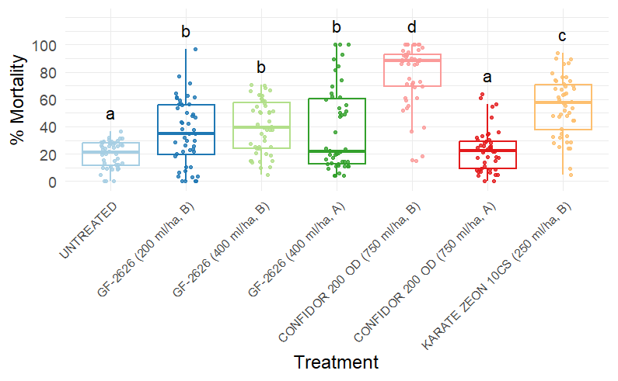
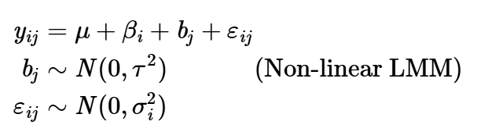
1. Which insecticide is more effective against Philaenus spumarius? (2017)

Slide 8
1.5. 1. WHICH insecticide is more effective against philaenus spumarius? (variability between plots)

Slide 9
2. Is it more efficient TO MAKE A FOLIAR APPLICATION OF A TREATMENT OR INJECT IT?

Slide 10
3. How persistent is each treatment and which of them is more persistent on time?

Slide 11
APPENDIX: TABLE AND CODES OF TREATMENTS IN 2017
2017 Treatments
Trt Num | Appl Code | Treatment Name | Material Name | Form Conc | Conc Unit | Form Type | Rate | Rate Unit | Appl Method
1 | B | SULFOXAFLOR | GF-2626 | 120 | g ai/l | SC | 200 | ml pr/ha | FOLIAR
2 | B | SULFOXAFLOR | GF-2626 | 120 | g ai/l | SC | 400 | ml pr/ha | FOLIAR
3 | A | SULFOXAFLOR | GF-2626 | 120 | g ai/l | SC | 400 | ml pr/ha | INJCTREE
4 | B | CONFIDOR 200 OD | CONFIDOR 200 OD | 200 | g ai/l | OD | 750 | ml pr/ha | FOLIAR
5 | A | CONFIDOR 200 OD | CONFIDOR 200 OD | 200 | g ai/l | OD | 750 | ml pr/ha | INJCTREE
6 | B | LAMBDA-CYHALOTHRIN | KARATE ZEON 10CS | 100 | g ai/l | CS | 250 | ml pr/ha | FOLIAR
7 | B | UNTREATED | UNTREATED

Slide 12
APPENDIX: TABLE AND CODES OF TREATMENTS IN 2018
2017 Treatments
Trt Num | Appl Code | Treatment Name | Material Name | Form Conc | Conc Unit | Form Type | Rate | Rate Unit | Appl Method
1 | A | CONFIDOR 200 OD | CONFIDOR 200 OD | 200 | g ai/l | OD | 750 | ml pr/ha | FOLIAR
2 | A | SULFOXAFLOR | GF-2626 | 120 | g ai/l | SC | 400 | ml pr/ha | FOLIAR
3 | A | EPIK | EPIK | 50 | g ai/kg | WP | 1500 | g pr/ha | FOLIAR
4 | B | SULFOXAFLOR | GF-2626 | 120 | g ai/l | SC | 400 | ml pr/ha | INJCTREE
5 | B | EPIK | EPIK | 50 | g ai/kg | WP | 1500 | g pr/ha | INJCTREE
6 | B | UNTREATED | UNTREATED

